Slide 1



DATA 400
The Impact of Minimum Wage on Wage Disparity Between Disabled and Non-Disabled Workers in the U.S. Service Industry
Presented by Margaret Nguyen

Slide 2

Tractable Data
IPUMS USA (Integrated Public Use Microdata Series)
FRED (Federal Reserve Economic Data)

Slide 3
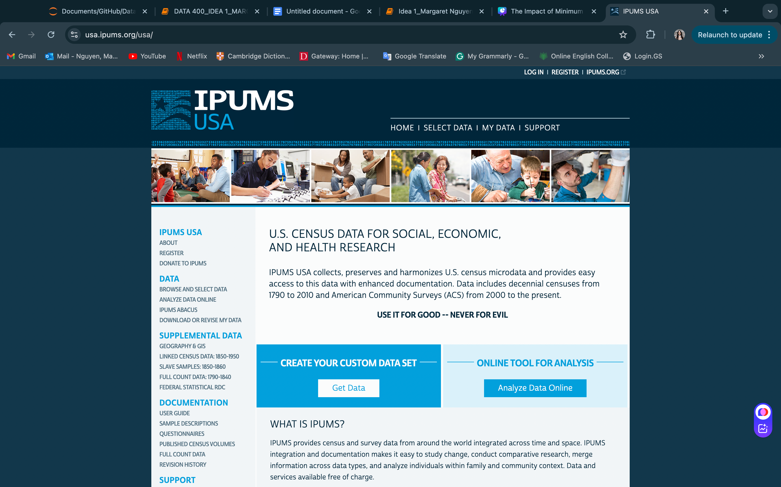
IPUMS USA
Overview:
IPUMS USA is a database providing access to over 60 high-precision samples of the U.S. population.
Data sourced from 16 federal censuses, the American Community Surveys (2000-present), and the Puerto Rican Community Surveys (2005-present).
Samples are harmonized with uniform codes and consistent documentation for easier analysis of social and economic changes.
Data Details:
Contains microdata, providing individual-level information about persons and households.
Particularly valuable for historical research, as aggregate census data may not be comparable across time.

Slide 4
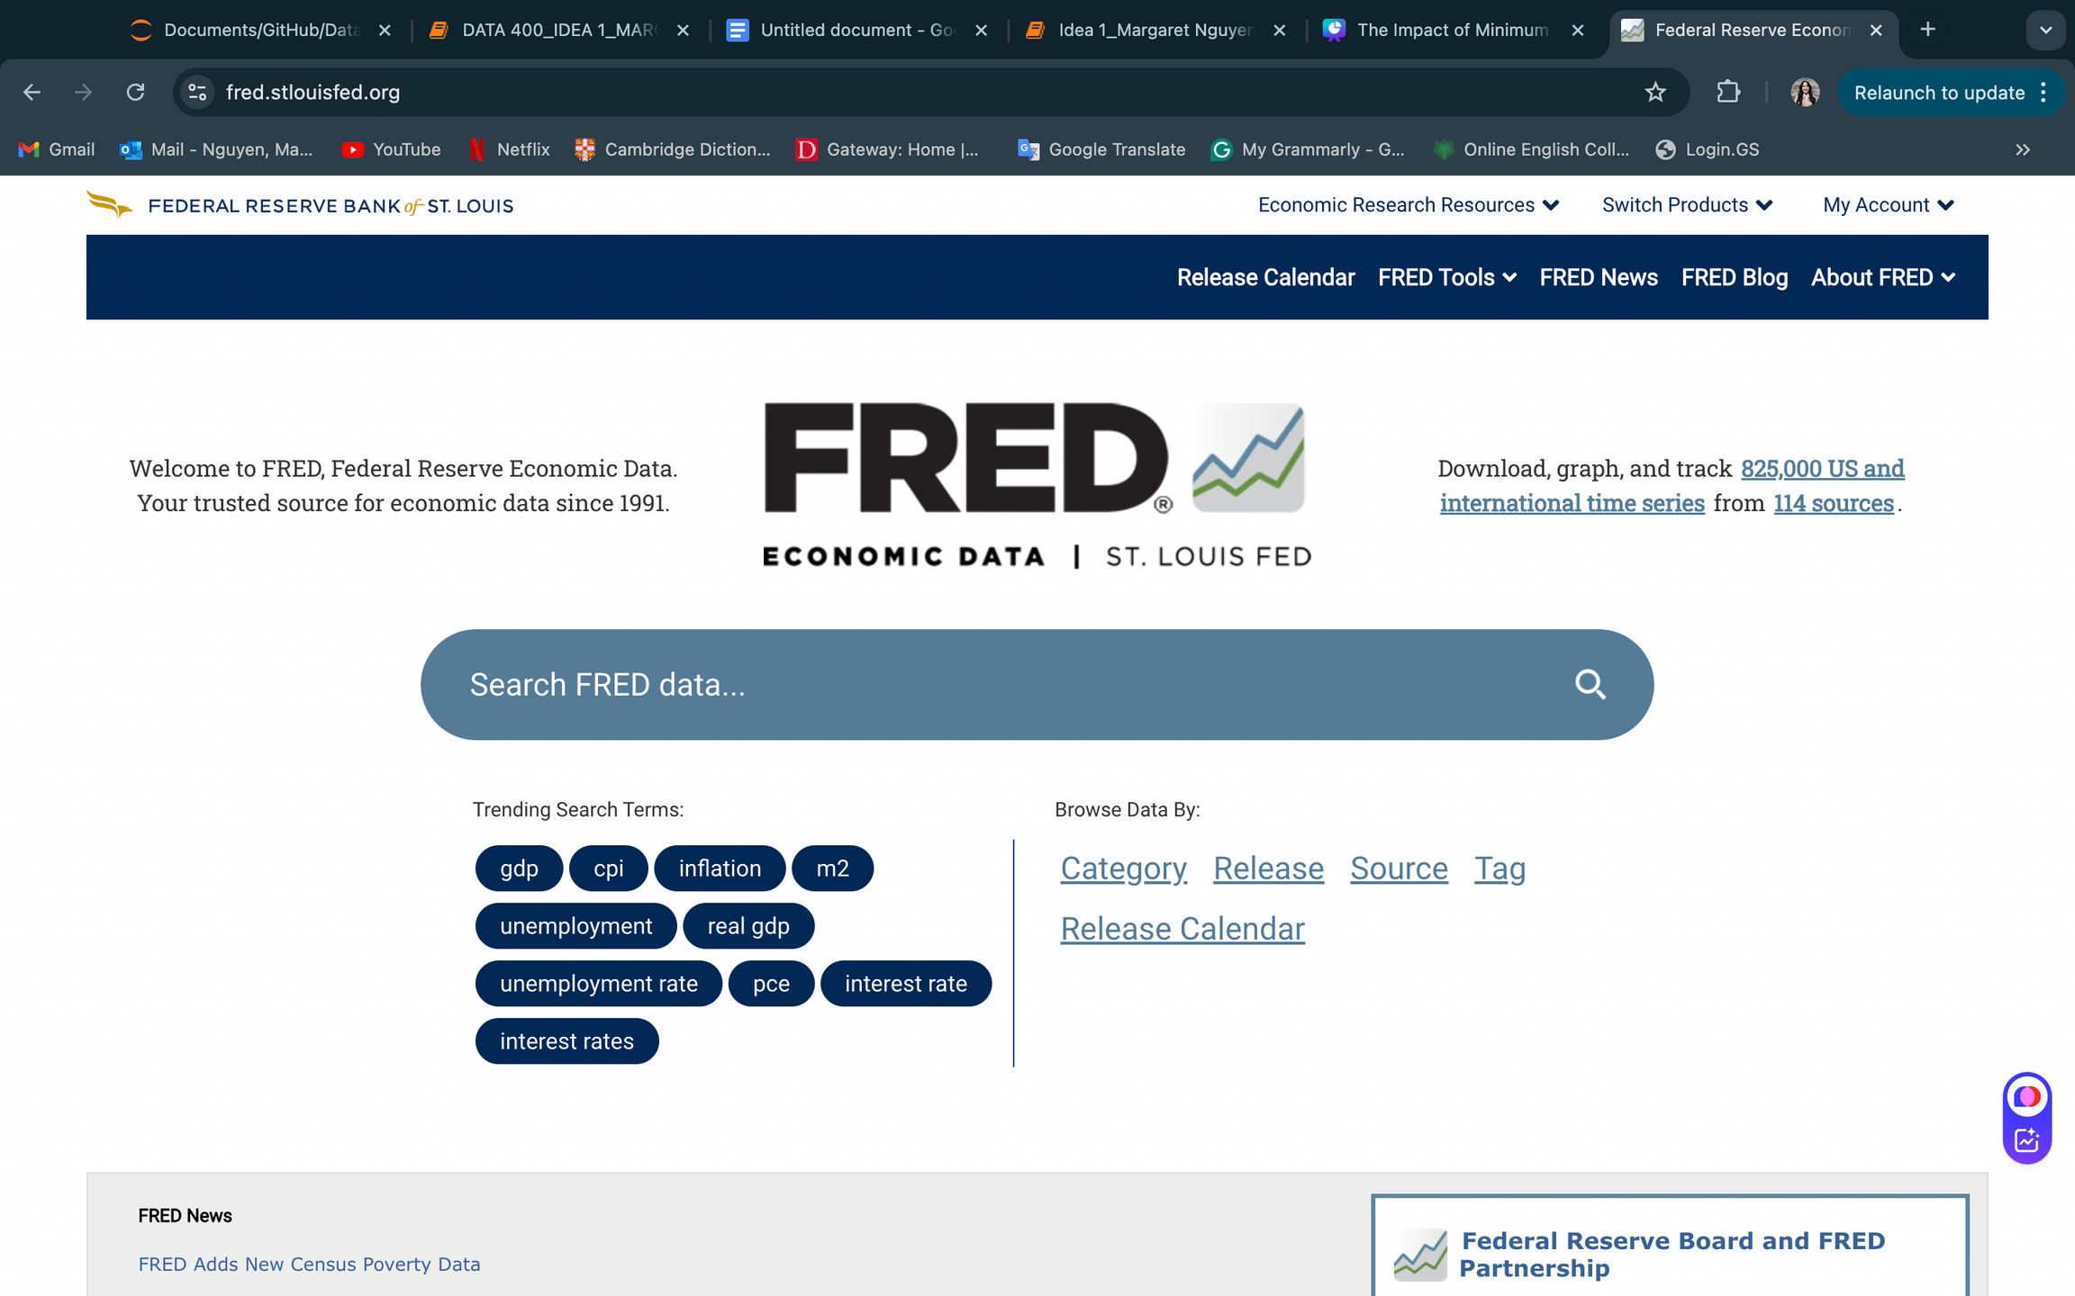
FRED
Overview:
Online database maintained by the Federal Reserve Bank of St. Louis.
Contains hundreds of thousands of economic data time series.
Data Sources and Growth
Initially featured data from U.S. government agencies (e.g., Board of Governors, Bureau of Economic Analysis, Bureau of Labor Statistics, and Census).
Expanded to include a broader range of national, regional, and international data.

Slide 5

Data Retrieval

Slide 6
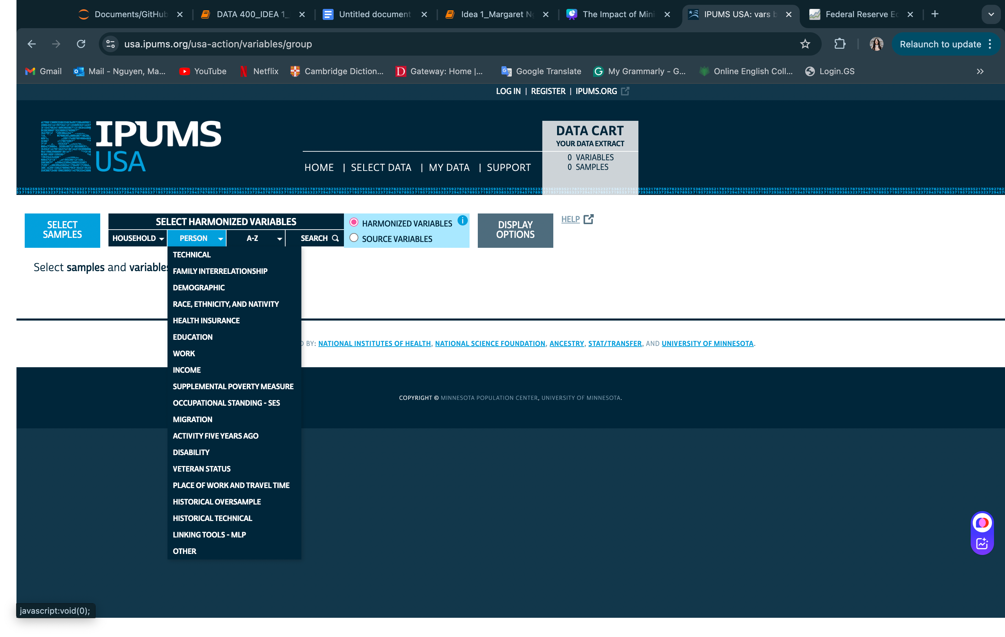

Data Retrieval

Slide 7
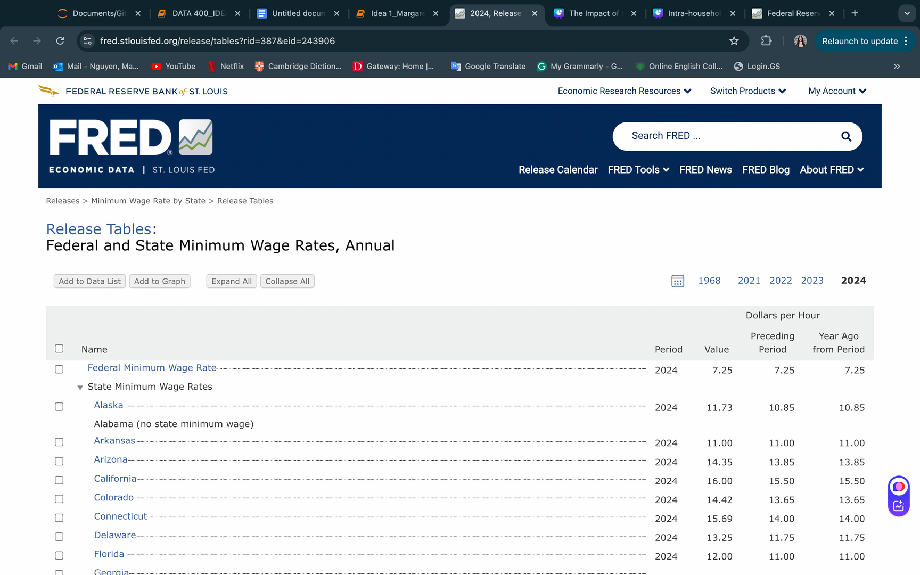
Data Retrieval

Slide 8
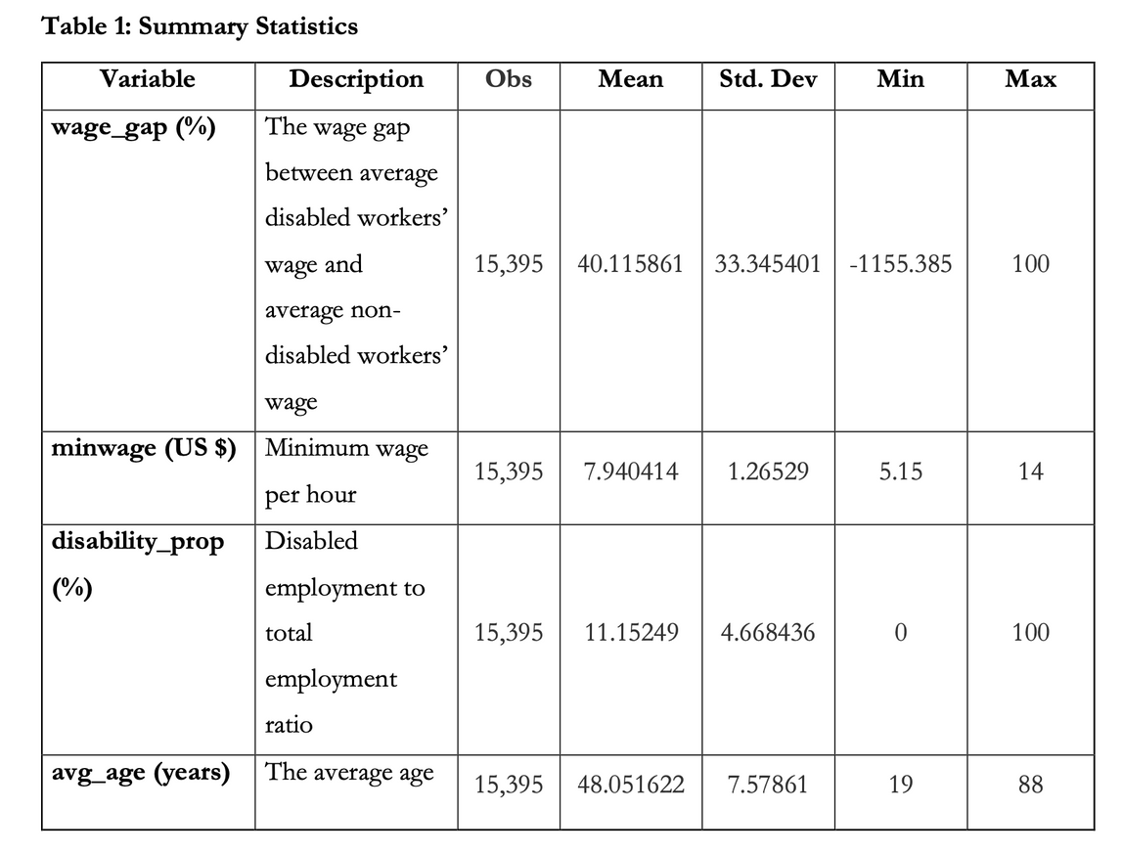

Exploratory Data Analysis

Slide 9

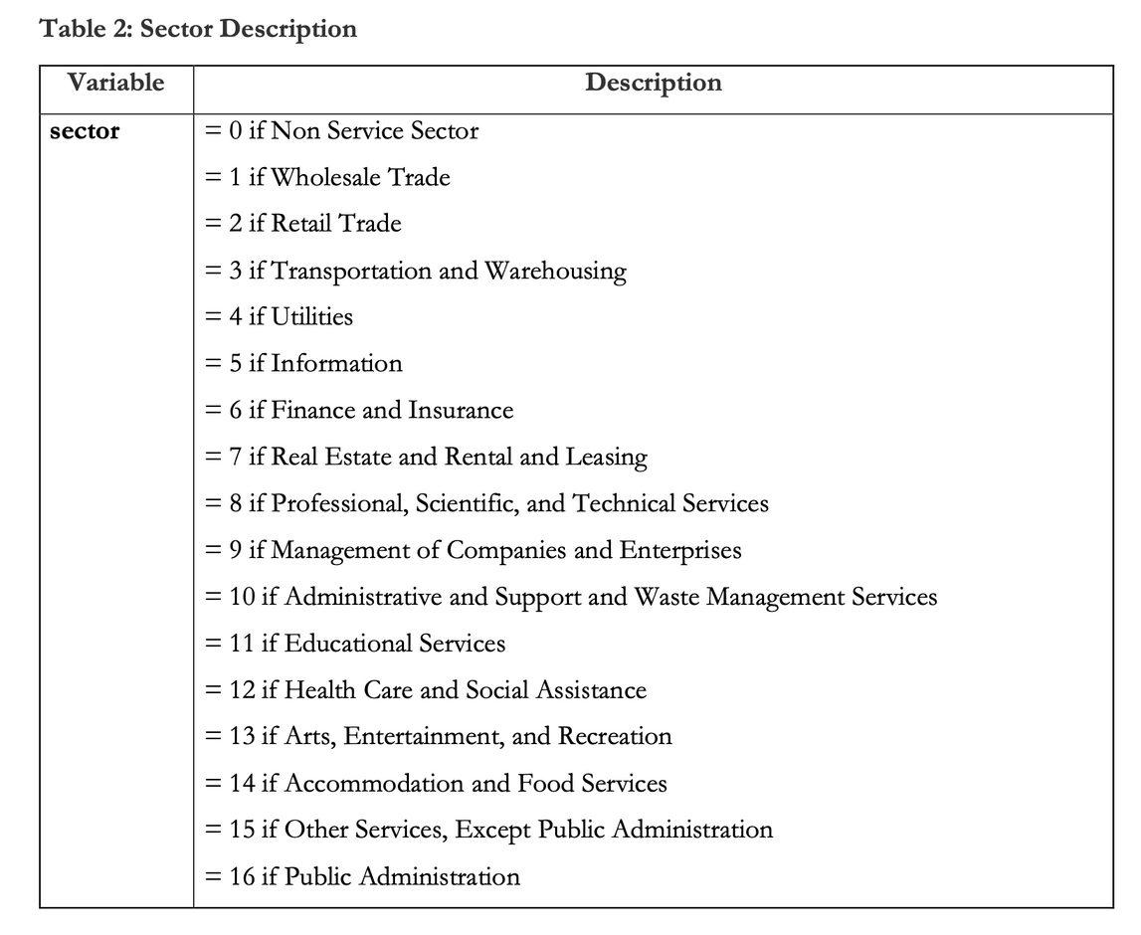
Exploratory Data Analysis

Slide 10
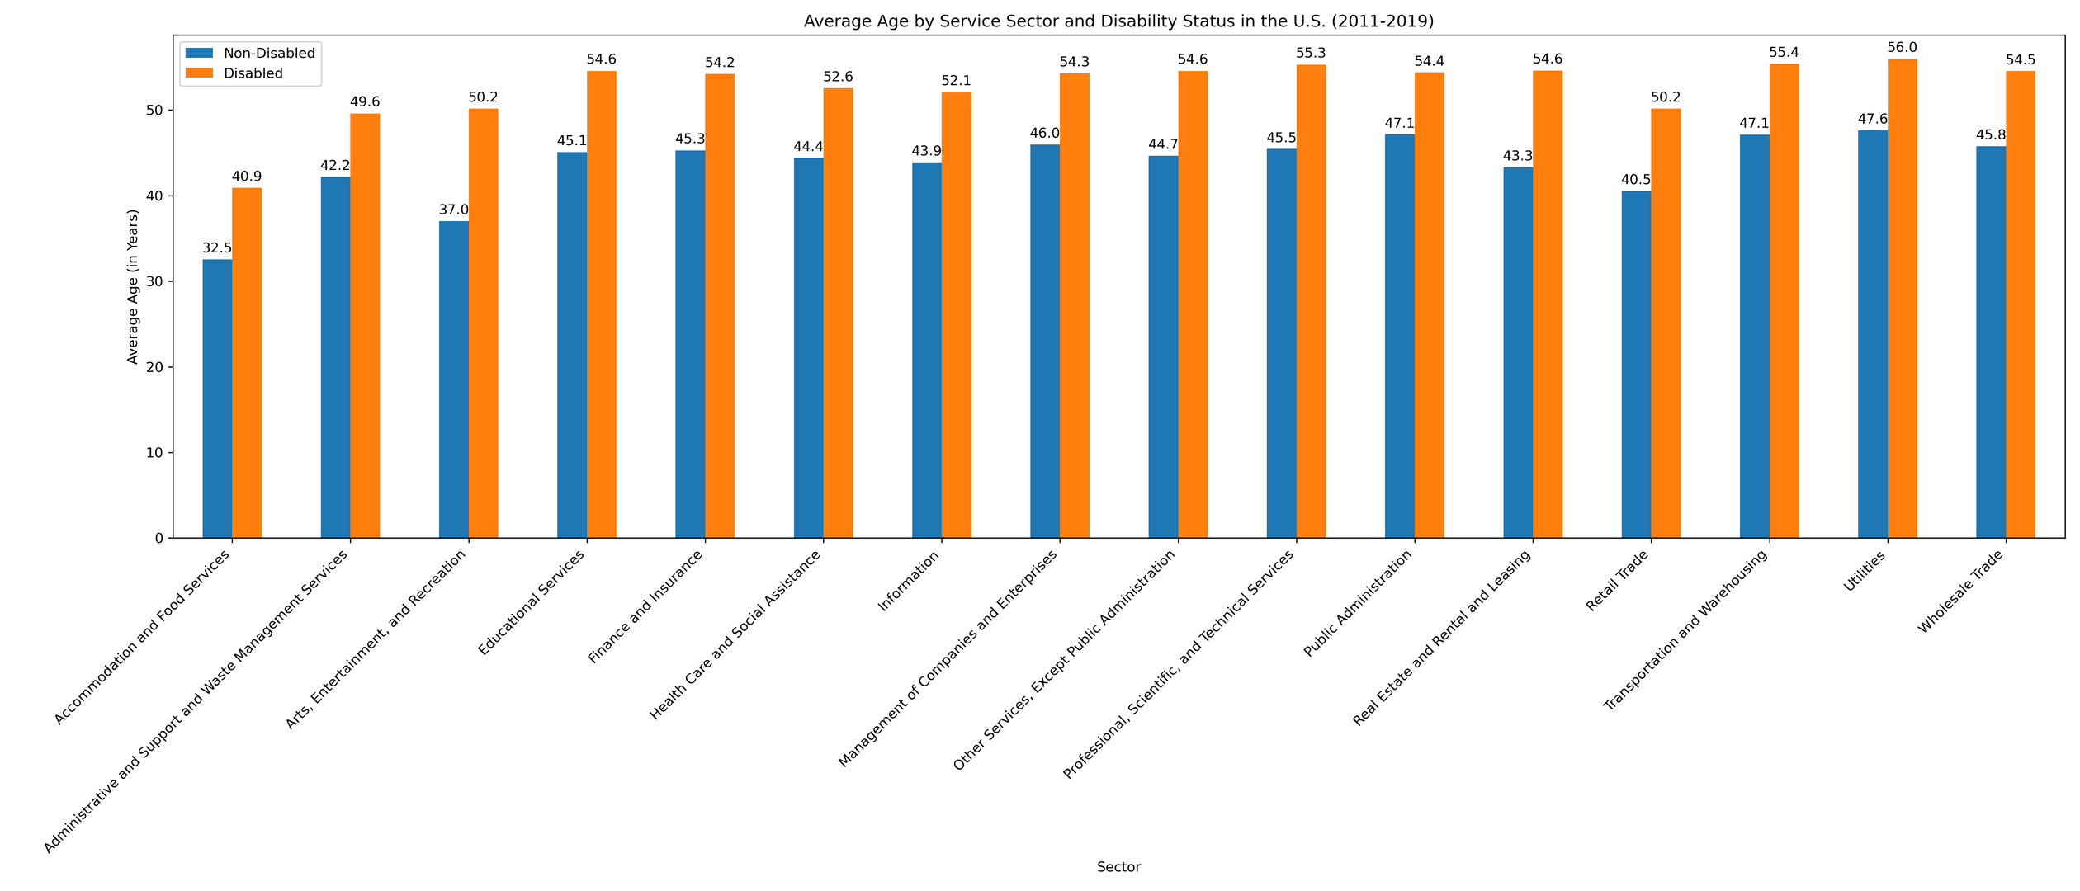
Exploratory Data Analysis

Slide 11
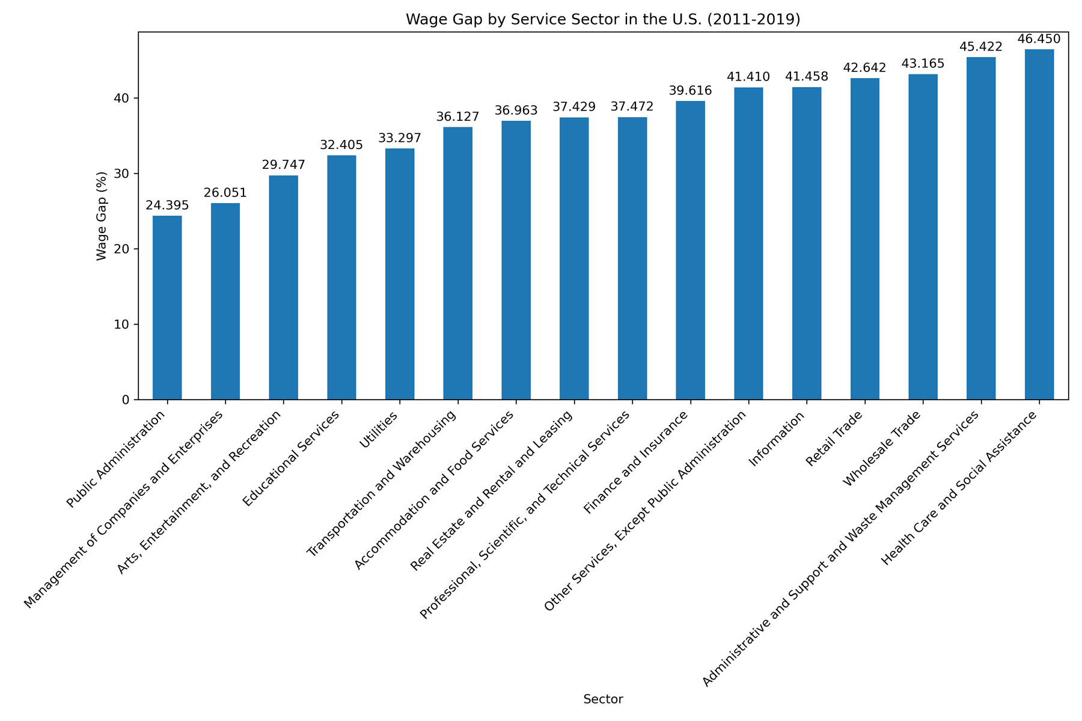
Exploratory Data Analysis

Slide 12
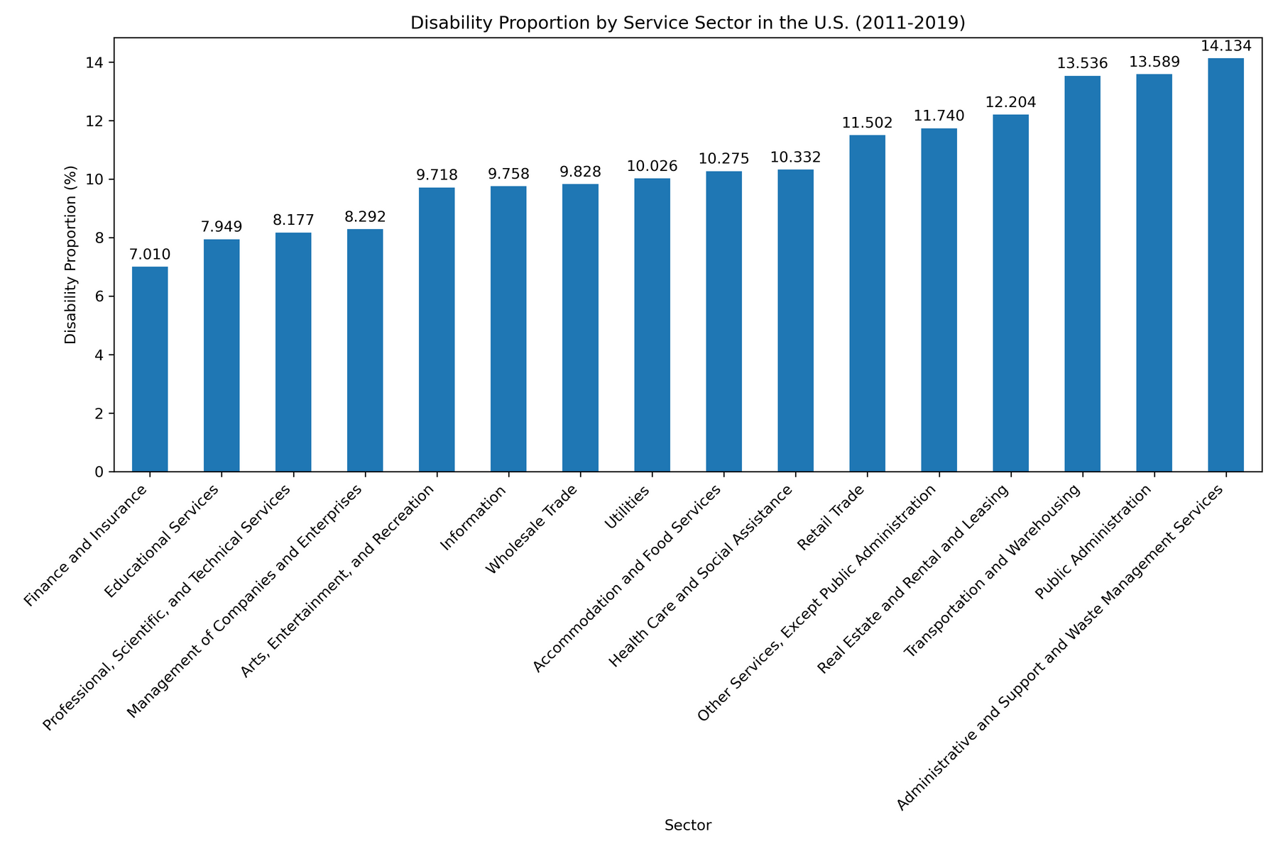
Exploratory Data Analysis

Slide 13
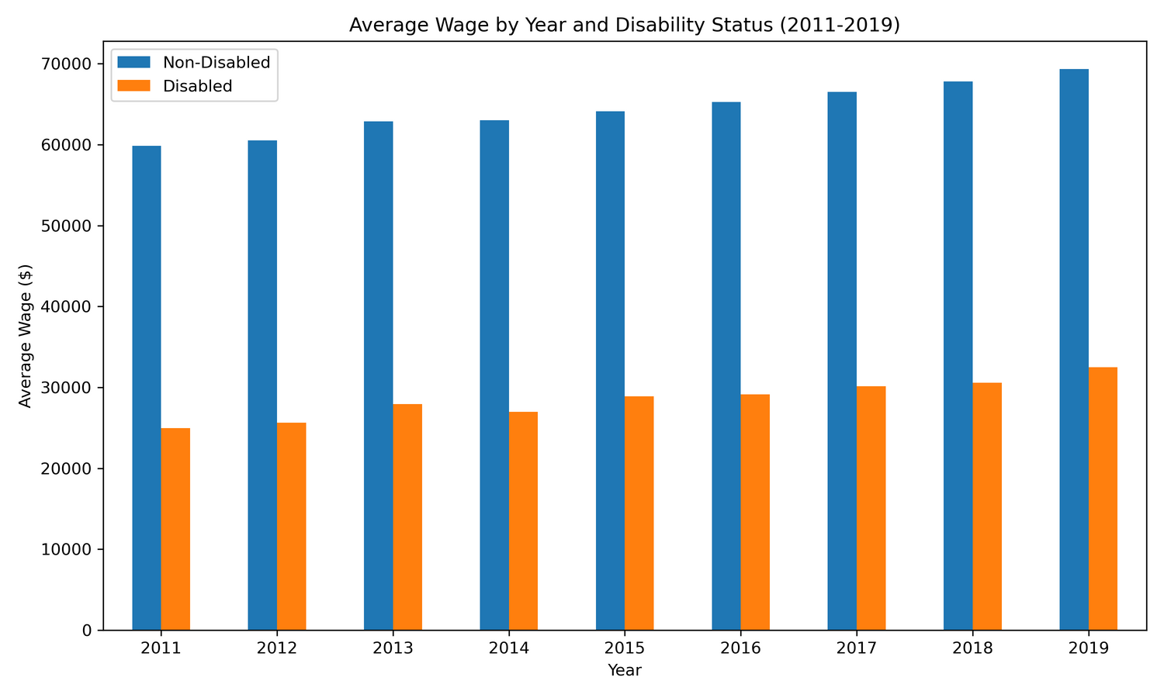
Exploratory Data Analysis

Slide 14

Implications for Stakeholders
Education: Barriers like discrimination and lack of accommodations for disabled workers contribute to wage gaps; addressing these can reduce disparities.
Minimum Wage Laws: Inadequate laws, such as Section 14(c), allow sub-minimum wages for disabled workers. Raising or removing these exemptions can help reduce disparities.
Industry Practices: Discrimination in hiring and promotions fuels wage inequality; inclusive practices can mitigate this.
Cost of Living/Regional Variations: Wage gaps increase in states with lower minimum wages and higher living costs, disproportionately impacting disabled workers.

Slide 15

Ethical, Legal, Societal Implications
A. Ethical Implications
Fairness and Equity
Exploitation Risk
B. Legal Implications
Discrimination Laws
Minimum Wage Laws
C. Societal Implications
Social Inclusion: Wage disparity reinforces disabled workers, limiting their ability to participate fully in society. Addressing this can lead to greater inclusion and social justice.
Economic Impact: Ensuring wage equity could help reduce poverty rates among disabled workers, leading to greater economic stability for this group and broader societal benefits from their increased purchasing power.

Slide 16

Model Specification

Slide 17

Thank You!

